Slide 1
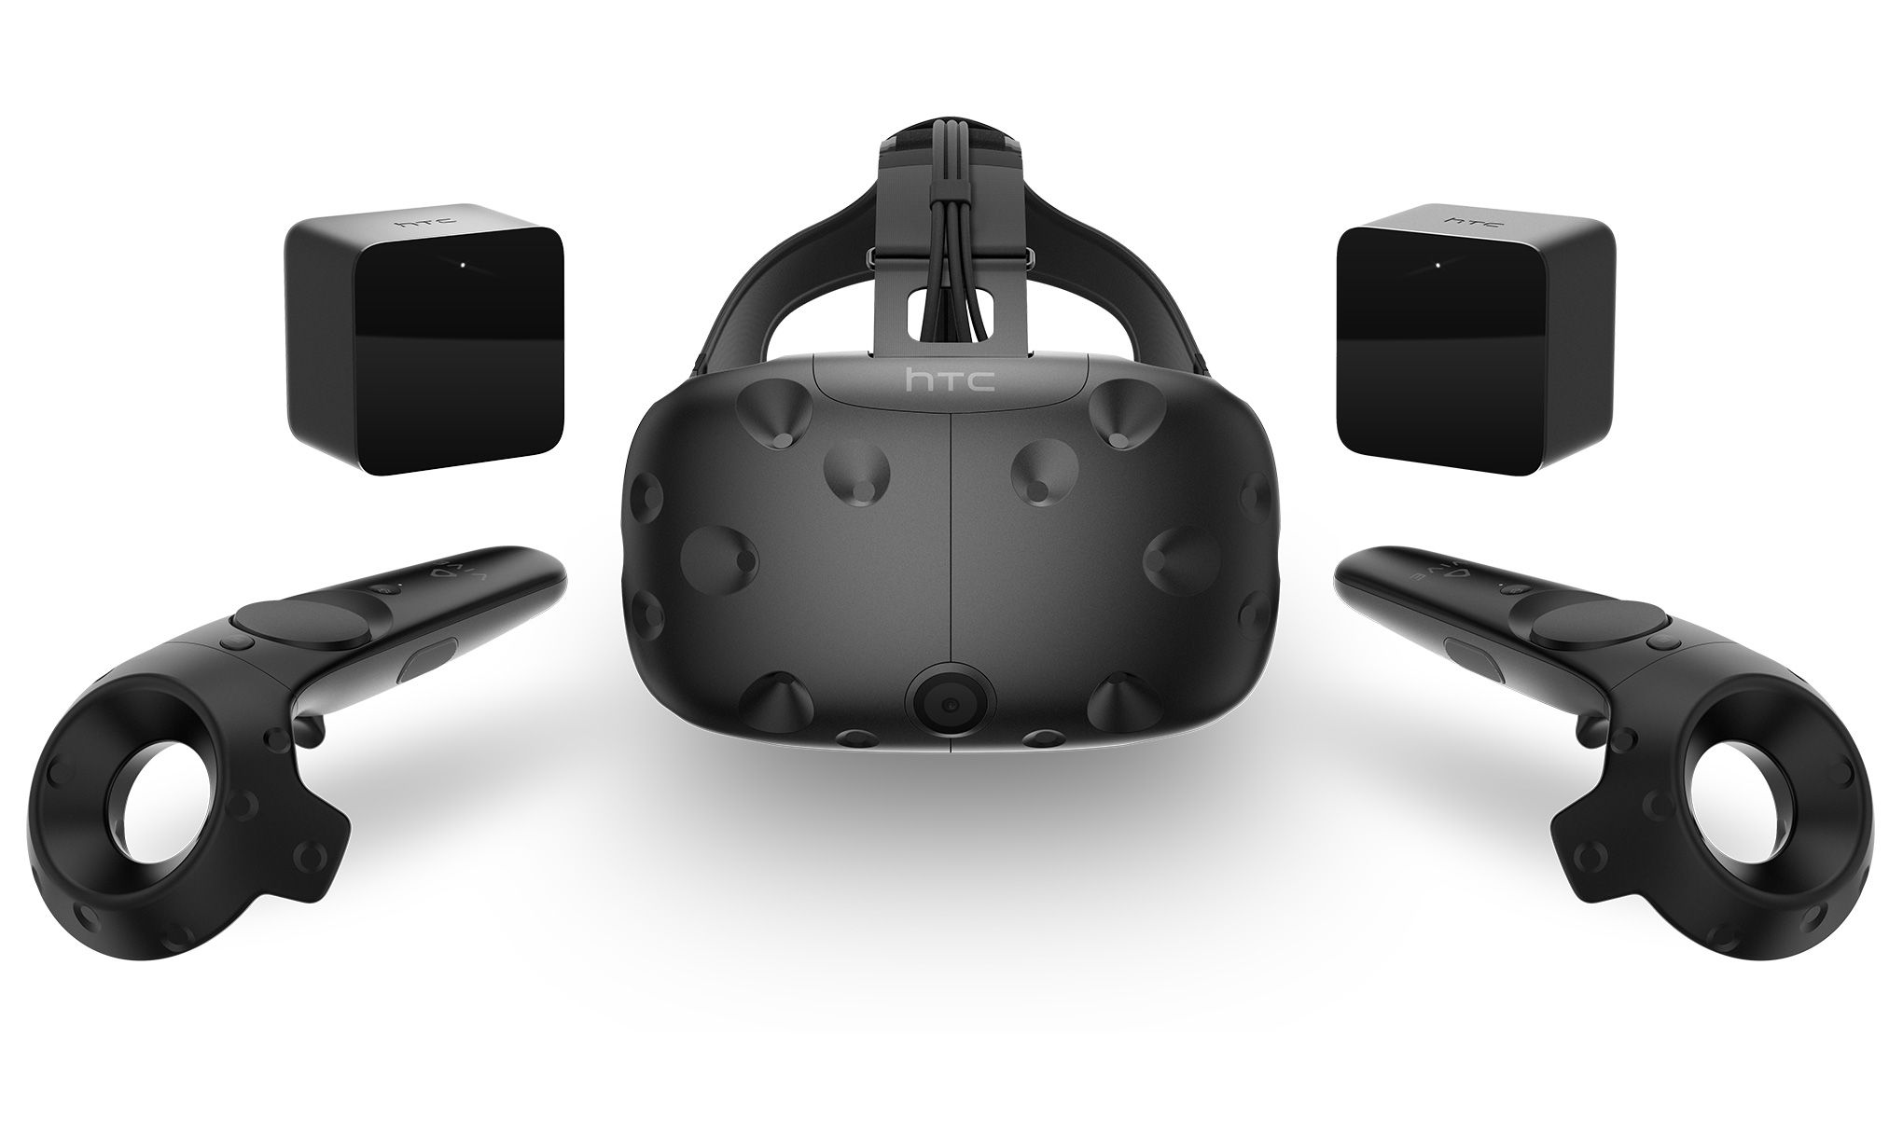
Servoing with HTC Vive
By: Dustan Kraus and Nathan Day
https://cdn.arstechnica.net/wp-content/uploads/sites/3/2016/10/htc-vive-set.0.jpg

Slide 2
q_{des}
q_{cmd}
q_{err}
Check steady state
x_{act}
X_{des}
IK
+/+
+/-
PI controller
King Louie
Trac-IK
q_{act}
Δq
K*J_{A}(q)^{T}
Δx
+/-

Slide 3
Servoing on King Louie with HTC Vive
PI Control on King Louie

Slide 4
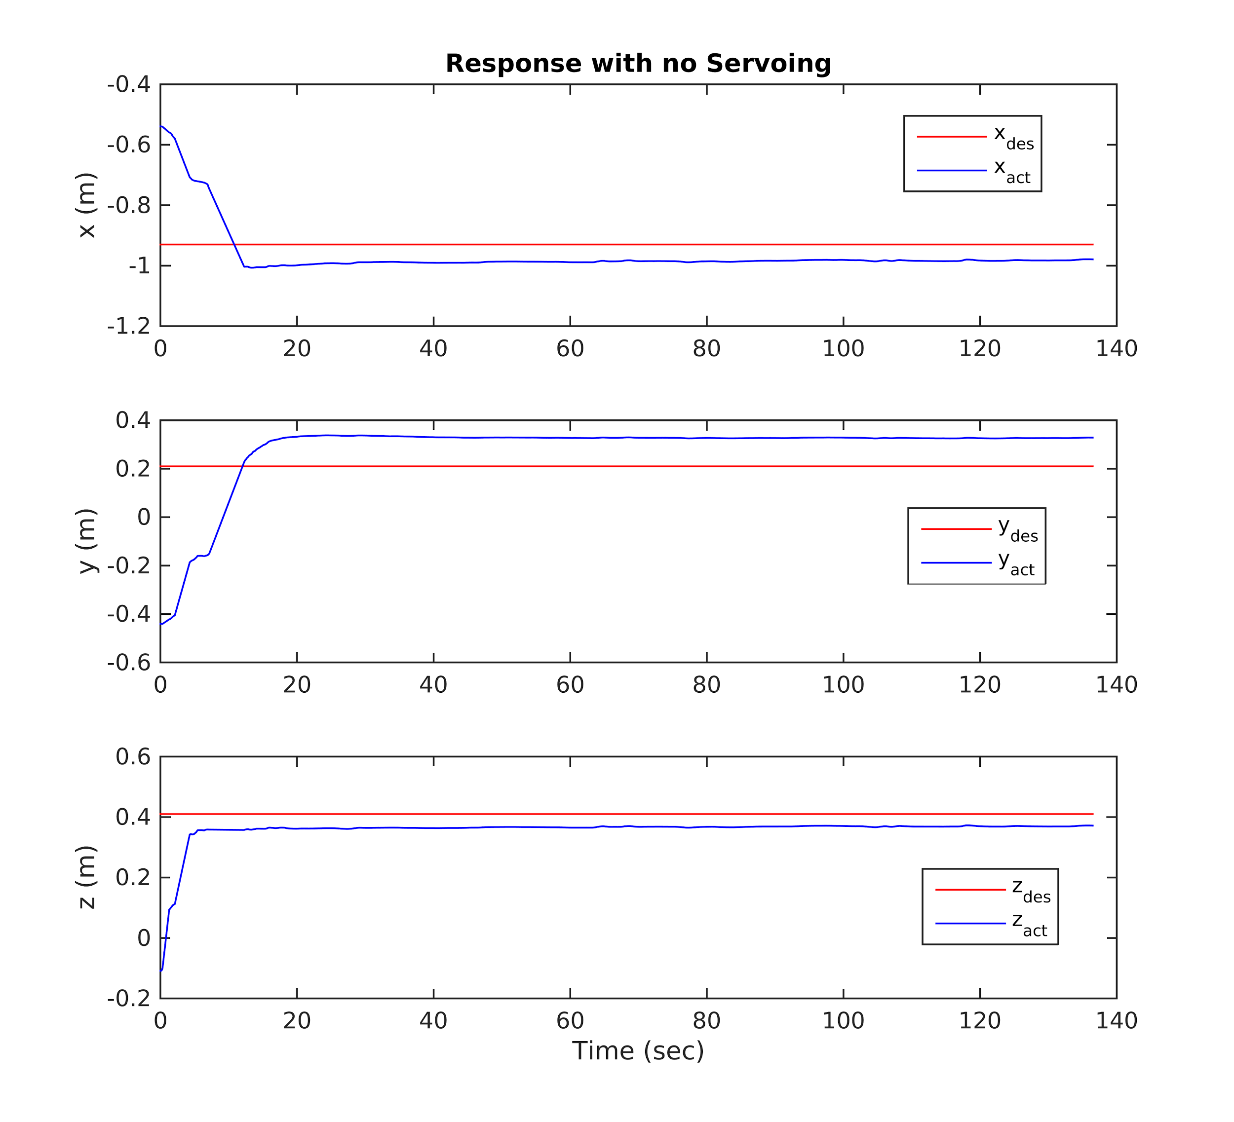
PI control on individual joints (joint angles found using inverse kinematics given DH parameters and a desired position)
With no servoing, there is a steady state error due to imperfect DH parameters

Slide 5
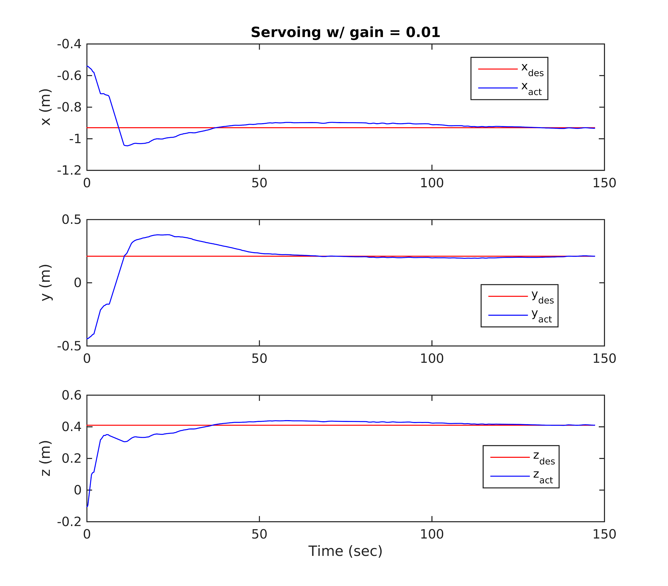
Servoing slowly pushes the position error to zero
Numerical Inverse Kinematics:
q(t_{k+1}) = q(t_{k}) + 𝚫q
Method 3: 𝚫q = (J_{A}^{T})*K*𝚫x
K = gain*(3x3 identity)

Slide 6
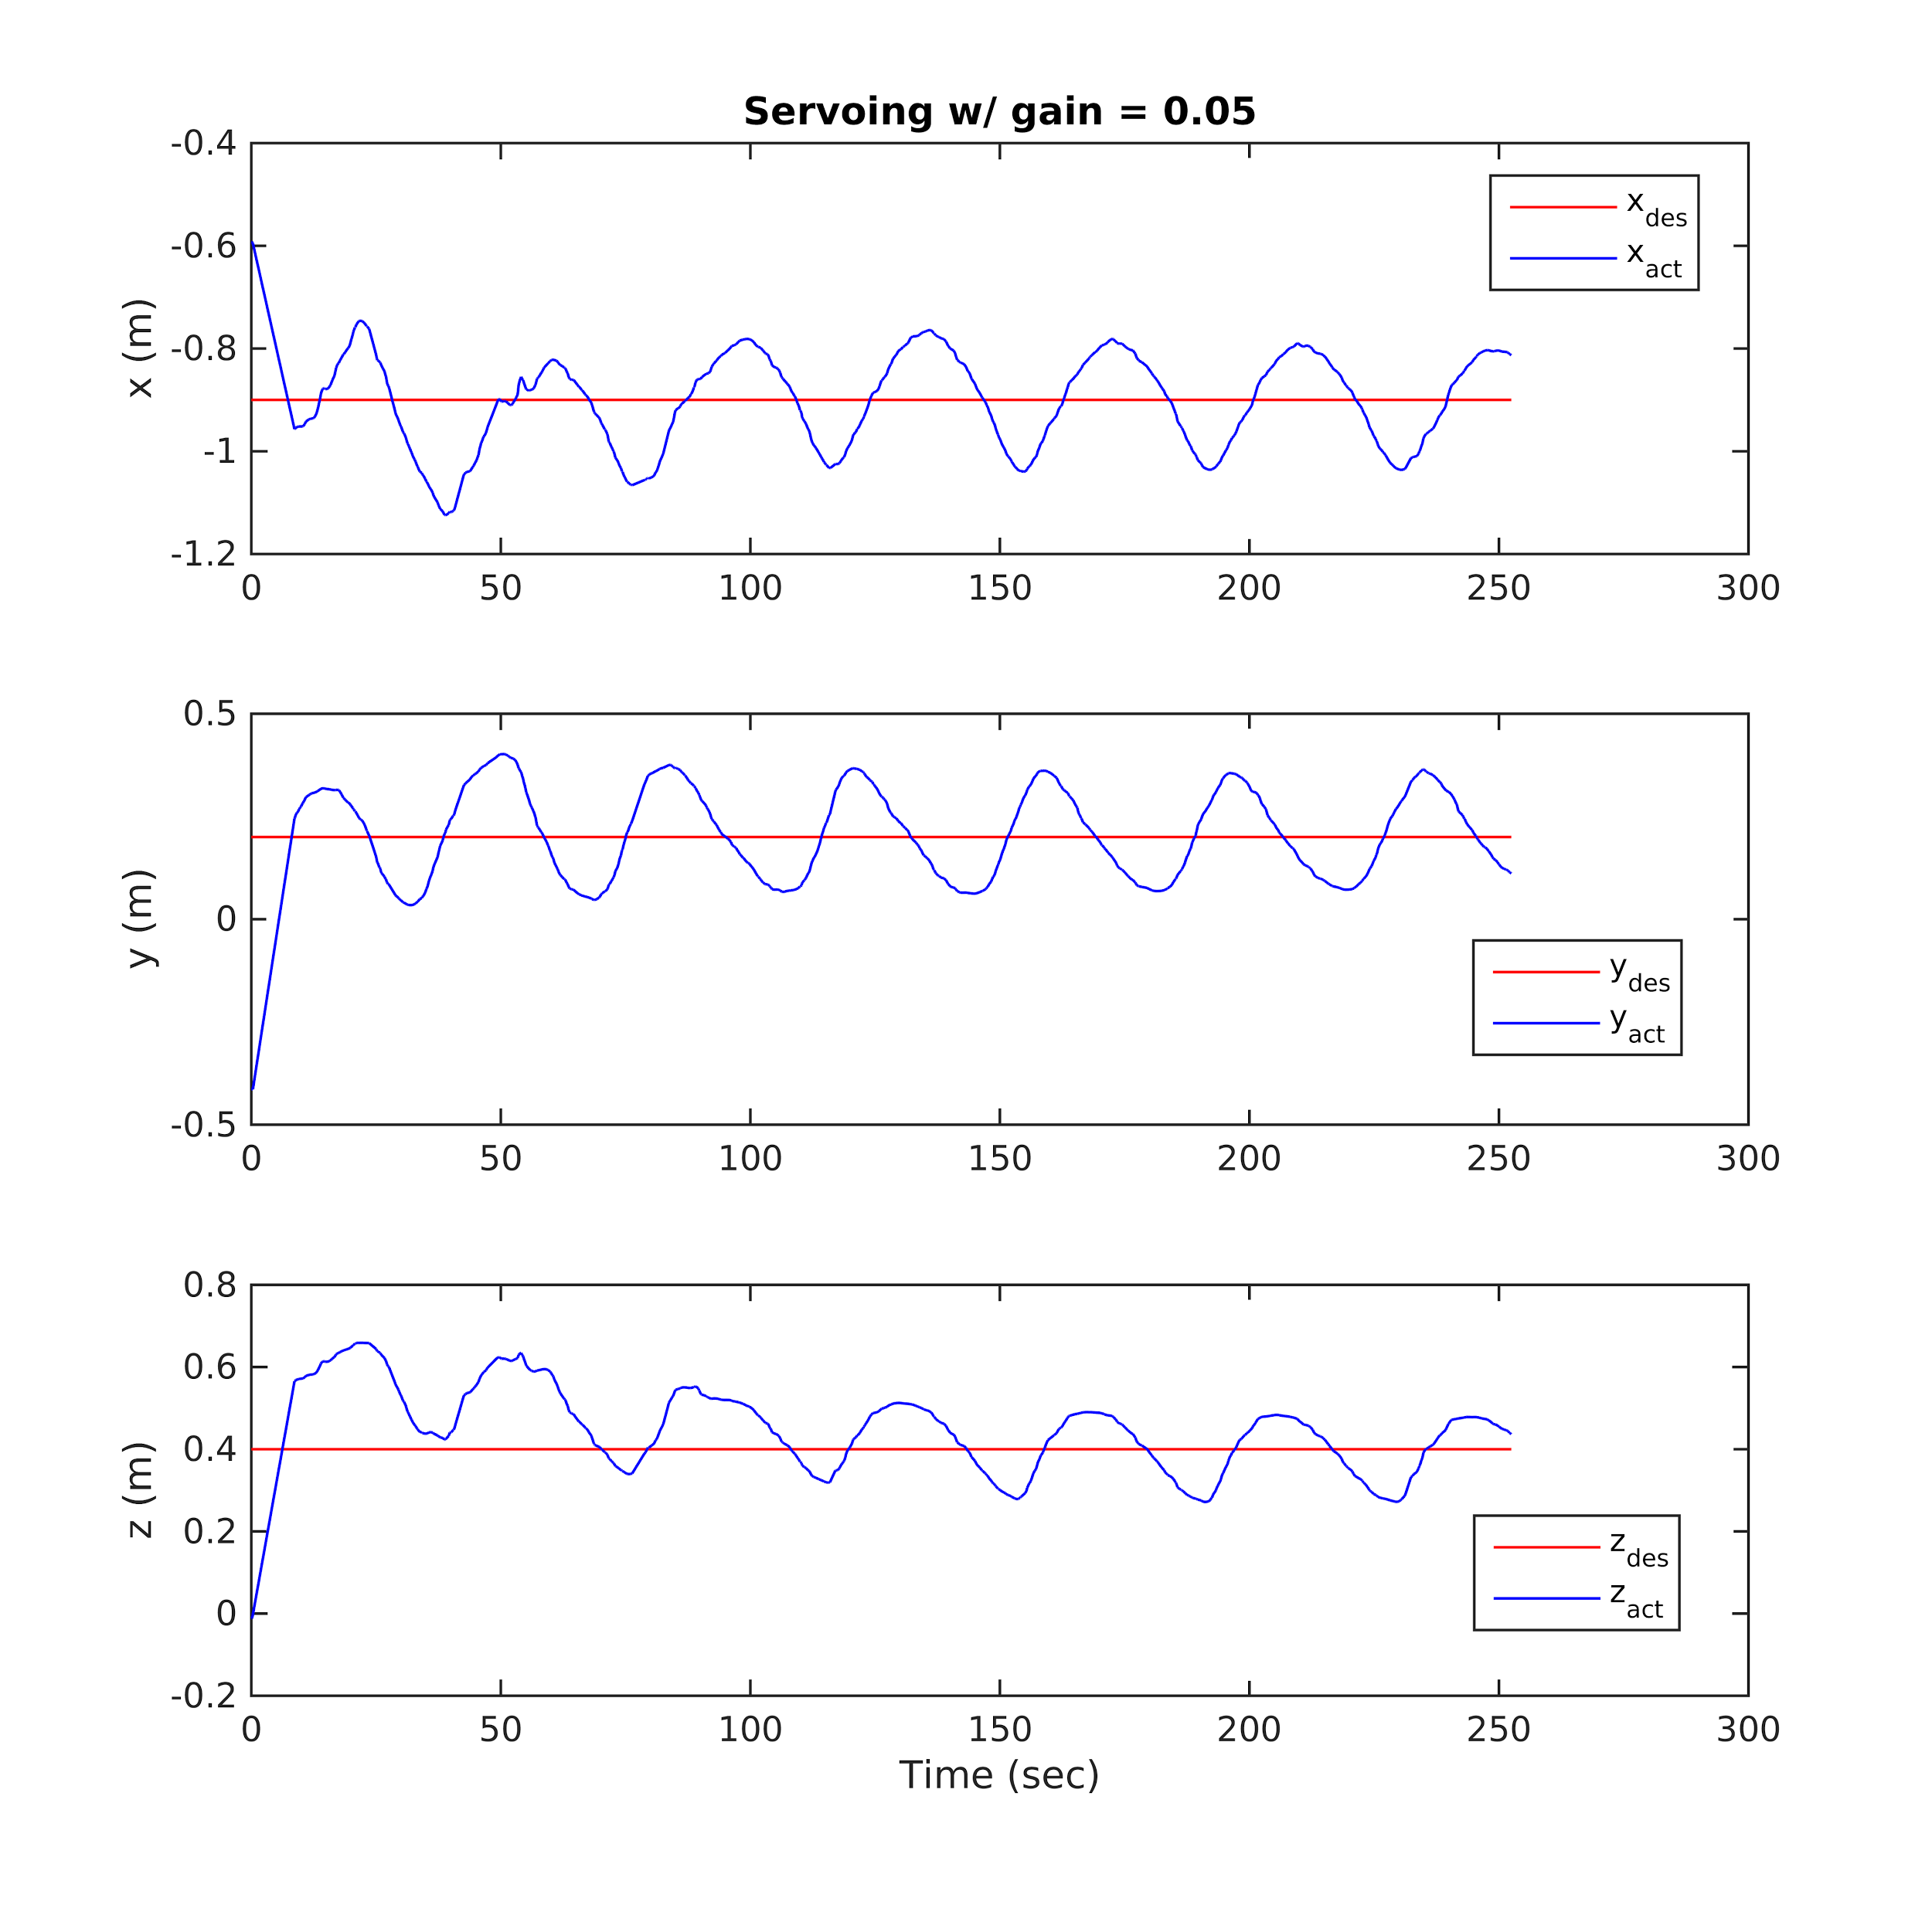
Adjusting gain matrix resulted in different responses
𝚫q = Ja’*K*𝚫x

